Slide 1
DHCP: more than IP addresses
DHCP can return more than just allocated IP address on subnet:
address of first-hop router for client
name and IP address of local DNS sever
network mask (indicating network versus host portion of address)
DHCP可以返回子网中分配的多个IP地址:
客户端的第一跳路由器地址
本地DNS服务器名称和IP地址
网络掩码(指示地址的网络与主机部分)

Slide 2
DHCP Leases
地址使用一旦租期过半，客户端开始尝试更新租期，这是通过向授予原始租期的DHCP服务器发送单播DHCPREQUEST消息来完成的
地址过期后，客户端必须停止使用地址，并通过广播DHCPDISCOVER消息获取一个新的地址
如果有多个DHCP服务器客户端可以选择最佳的“报价”
Address Usage
Client begins to attempt to renew the lease once half the lease time has expired and this is done by sending a unicast DHCPREQUEST message to the DHCP server that granted the original lease
After address has expired client must stop using address and acquire a new address by broadcasting a DHCPDISCOVER message
If there are more than one DHCP server client can select the best “offer”
Address Leases
Manual Lease: Network manager explicitly assigns all IP addresses
Automatic Lease: DHCP server permanently assigns some addresses and dynamically others
Dynamic Lease: DHCP server dynamically assigns IP addresses for a specific period of time when permanent address is not required
“手动租赁”:网管显式分配所有IP地址。
“自动租赁”:DHCP服务器永久分配部分地址，动态分配其他地址
动态租约:在不需要永久地址的情况下，DHCP服务器在指定的时间段内动态分配IP地址

Slide 3


DHCP: example
DHCP
DHCP
UDP
IP
Eth
Phy
Connecting laptop will use DHCP to get IP address, address of first-hop router, address of DNS server.
DHCP
DHCP
DHCP
DHCP
DHCP REQUEST message encapsulated in UDP, encapsulated in IP, encapsulated in Ethernet
DHCP
DHCP
UDP
IP
Eth
Phy
168.1.1.1
DHCP
DHCP
DHCP
Ethernet frame broadcast (dest: FFFFFFFFFFFF) on LAN, received at router running DHCP server
DHCP
router with DHCP
server built into
router
连接的笔记本电脑将通过DHCP获取IP地址，第一级路由器地址，DNS服务器地址。
UDP被封装DHCP REQUEST报文，IP封装DHCP REQUEST报文，以太网封装DHCP REQUEST报文
以太网帧广播(dest: ffffffffff)在局域网上，由运行DHCP服务器的路由器接收
从以太网中提取的IP数据报从IP数据报中提取UDP, DHCP从UDP中提取的请求消息
IP datagram extracted from Ethernet , UDP extracted from IP datagram, DHCP REQUEST message extracted from UDP

Slide 4
DHCP: example
DHCP
UDP
IP
Eth
Phy
DHCP server formulates DHCP ACK containing client’s IP address, IP address of first-hop router for client, name & IP address of DNS server
DHCP
DHCP
DHCP
DHCP
encapsulated DHCP server reply forwarded to client, demuxing up to DHCP at client
DHCP
DHCP
UDP
IP
Eth
Phy
DHCP
DHCP
DHCP
router with DHCP
server built into
router
client now knows its IP address, name and IP address of DNS server, IP address of its first-hop router
DHCP
DHCP服务器制定DHCP ACK，包含客户端的IP地址、客户端的第一跳路由器IP地址、DNS服务器的名称和IP地址
封装的DHCP服务器回复转发给客户端，demuxing到客户端DHCP
客户端现在知道它的IP地址，DNS服务器的名称和IP地址，它的第一跳路由器的IP地址

Slide 5
DHCP: Wireshark output (home LAN)
Message type: Boot Request (1)
Hardware type: Ethernet
Hardware address length: 6
Hops: 0
Transaction ID: 0x6b3a11b7
Seconds elapsed: 0
Bootp flags: 0x0000 (Unicast)
Client IP address: 0.0.0.0 (0.0.0.0)
Your (client) IP address: 0.0.0.0 (0.0.0.0)
Next server IP address: 0.0.0.0 (0.0.0.0)
Relay agent IP address: 0.0.0.0 (0.0.0.0)
Client MAC address: Wistron_23:68:8a (00:16:d3:23:68:8a)
Server host name not given
Boot file name not given
Magic cookie: (OK)
Option: (t=53,l=1) DHCP Message Type = DHCP Request
Option: (61) Client identifier
Length: 7; Value: 010016D323688A;
Hardware type: Ethernet
Client MAC address: Wistron_23:68:8a (00:16:d3:23:68:8a)
Option: (t=50,l=4) Requested IP Address = 192.168.1.101
Option: (t=12,l=5) Host Name = "nomad"
Option: (55) Parameter Request List
Length: 11; Value: 010F03062C2E2F1F21F92B
1 = Subnet Mask; 15 = Domain Name
3 = Router; 6 = Domain Name Server
44 = NetBIOS over TCP/IP Name Server
……
Message type: Boot Reply (2)
Hardware type: Ethernet
Hardware address length: 6
Hops: 0
Transaction ID: 0x6b3a11b7
Seconds elapsed: 0
Bootp flags: 0x0000 (Unicast)
Client IP address: 192.168.1.101 (192.168.1.101)
Your (client) IP address: 0.0.0.0 (0.0.0.0)
Next server IP address: 192.168.1.1 (192.168.1.1)
Relay agent IP address: 0.0.0.0 (0.0.0.0)
Client MAC address: Wistron_23:68:8a (00:16:d3:23:68:8a)
Server host name not given
Boot file name not given
Magic cookie: (OK)
Option: (t=53,l=1) DHCP Message Type = DHCP ACK
Option: (t=54,l=4) Server Identifier = 192.168.1.1
Option: (t=1,l=4) Subnet Mask = 255.255.255.0
Option: (t=3,l=4) Router = 192.168.1.1
Option: (6) Domain Name Server
Length: 12; Value: 445747E2445749F244574092;
IP Address: 68.87.71.226;
IP Address: 68.87.73.242;
IP Address: 68.87.64.146
Option: (t=15,l=20) Domain Name = "hsd1.ma.comcast.net."
request
reply

Slide 6
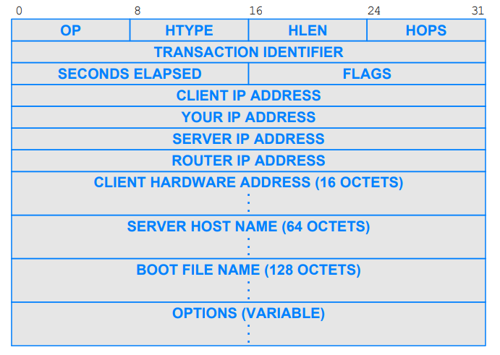
DHCP Message Format
(There are >100 different options)

Slide 7
Message Types [RFC2131]
DHCPDISCOVER: Broadcast by a client to find available DHCP servers
DHCPOFFER: Response from a server to a DHCPDISCOVER and offering IP address and other parameters
DHCPREQUEST: Message from a client to servers that does one of the following:
Requests the parameters offered by one of the servers and declines all other offers
Verifies a previously allocated address after a system or network change (a reboot for example)
Requests the extension of a lease on a particular address
DHCPACK: Acknowledgement from server to client with parameters, including IP address
DHCPNACK: Negative acknowledgement from server to client, indicating that the client's lease has expired or that a requested IP address is incorrect
DHCPDECLINE: Message from client to server indicating that the offered address is already in use
DHCPRELEASE: Message from client to server canceling remainder of a lease and relinquishing network address
DHCPINFORM: Message from a client that already has an IP address (manually configured for example), requesting further configuration parameters from the DHCP server

Slide 8
DCHP: Protocol in Use
Server 1
Client
Server 2
DHCPDISCOVER
DHCPOFFER
DHCPOFFER
Select config
DHCPREQUEST (decline)
May be repeated to confirm/ renew configuration
DHCPREQUEST
(accept)
DHCPACK
Period of Normal Operation
DHCPRELEASE

Slide 9
DHCP Pros
Relieves the network administrator of manual configuration
Devices can be moved from network to network and automatically obtain valid configuration parameters for the current network
IP addresses are only allocated when needed
It is possible to re-use IP addresses after lease
Especially considering mobile clients
Reduction in the total number of addresses in use
减轻网络管理员的手工配置。
设备可以从一个网络移动到另一个网络，自动获取当前网络的有效配置参数
IP地址只在需要时分配
租赁后的IP地址是可以重用的，特别是考虑到移动客户端
减少使用的地址总数

Slide 10
DHCP Limitations
Server Issues
A machine to run the DHCP server continually is required
When DHCP server is unavailable, clients may be unable to access network
Security Problems
Uses UDP, an unreliable and insecure protocol
DHCP is an unauthenticated protocol
When connecting to a network, the user is not required to provide credentials in order to obtain a lease
Malicious users with physical access to the DHCP-enabled network can instigate a denial-of-service attack on DHCP servers by requesting many leases from the server, thereby depleting the number of leases that are available to other DHCP clients
需要一台机器来持续运行DHCP服务器
当DHCP服务器不可用时，可能会导致客户端无法接入
使用UDP协议，这是一种不可靠、不安全的协议
DHCP是一种未经认证的协议
当连接到网络时，用户不需要提供凭据来获得租约
恶意用户通过物理访问启用DHCP的网络，可以向DHCP服务器发起拒绝服务攻击，向服务器请求多个租约，从而耗尽其他DHCP客户端可用的租约数量

Slide 11
What is the Issue
Q: are there enough 32-bit IP addresses?
ICANN allocated last chunk of IPv4 addresses to RRs in 2011
Not that many unique addresses
2³² = 4,294,967,296 (just over four billion)
Plus, some are reserved for special purposes
And, addresses are allocated in large blocks
And, many devices need IP addresses
Computers, tablets, routers, watches, fridges, …
Solutions include
Short-term solution: NAT & DHCP helps IPv4 address exhaustion
Long-term solution: IPv6 has 128-bit address space

